Slide 1
Coastal management
A virtual field study
presented by :
Russell Darnley & Cherryl Ellis
HSIE Faculty
Sydney Secondary College- Leichhardt Campus

Slide 2
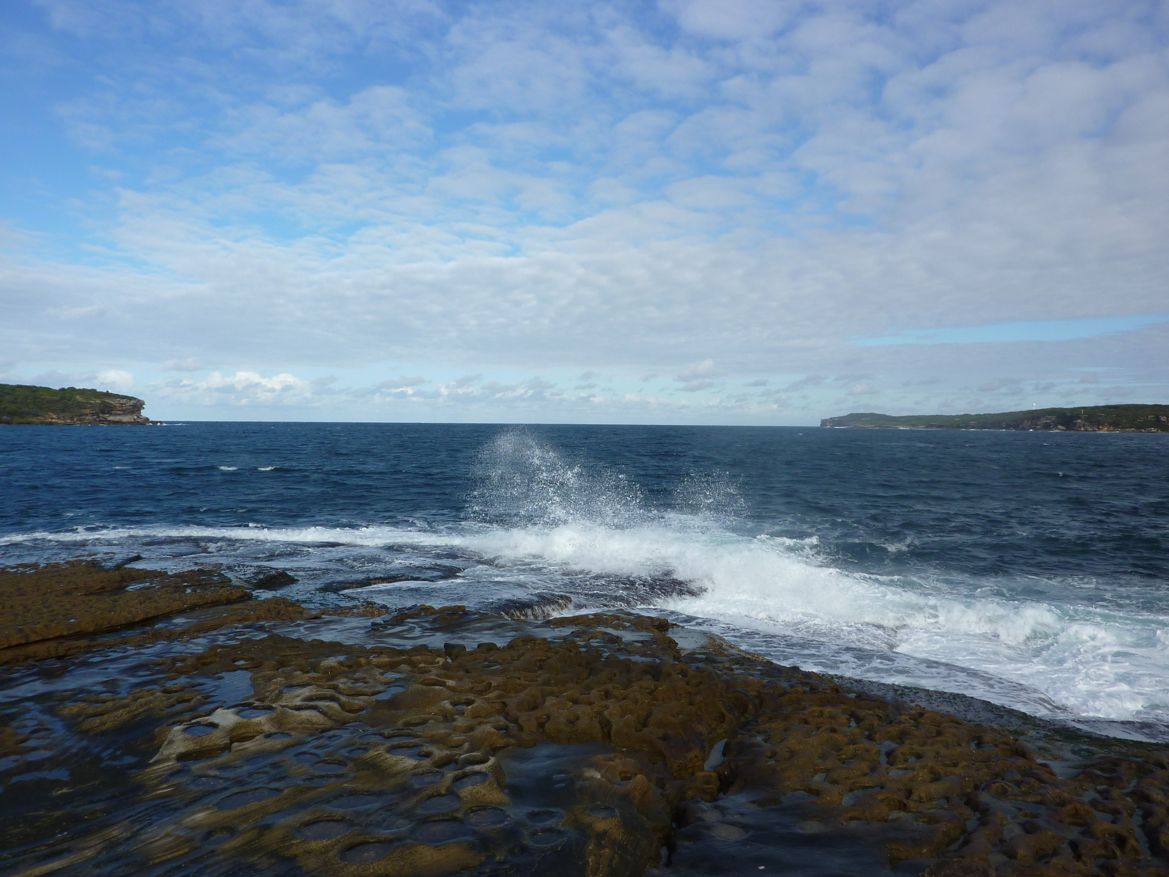
Botany Bay
A Virtual Field Study
#bbvirtual

Slide 3

Asking geographical questions
what is there?
where is it?
why is it there?
what are the effects of it being there?
how is it changing over time?
should it be like this?
what groups are involved?
what do different groups think?
what action is appropriate?
NSW Board of Studies. Geography, Years 7–10 Syllabus. June 2003. Page 20.

Slide 4
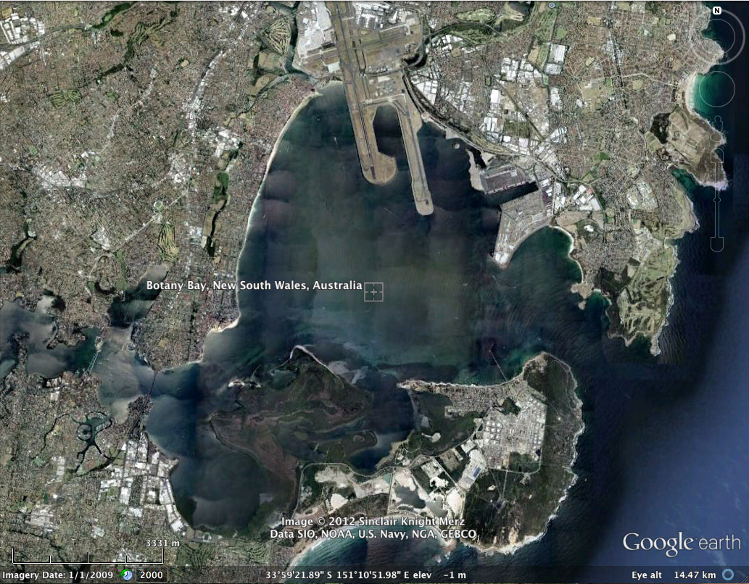
What’s there? Where is it? (5.5)
Locate with Google Earth

Slide 5
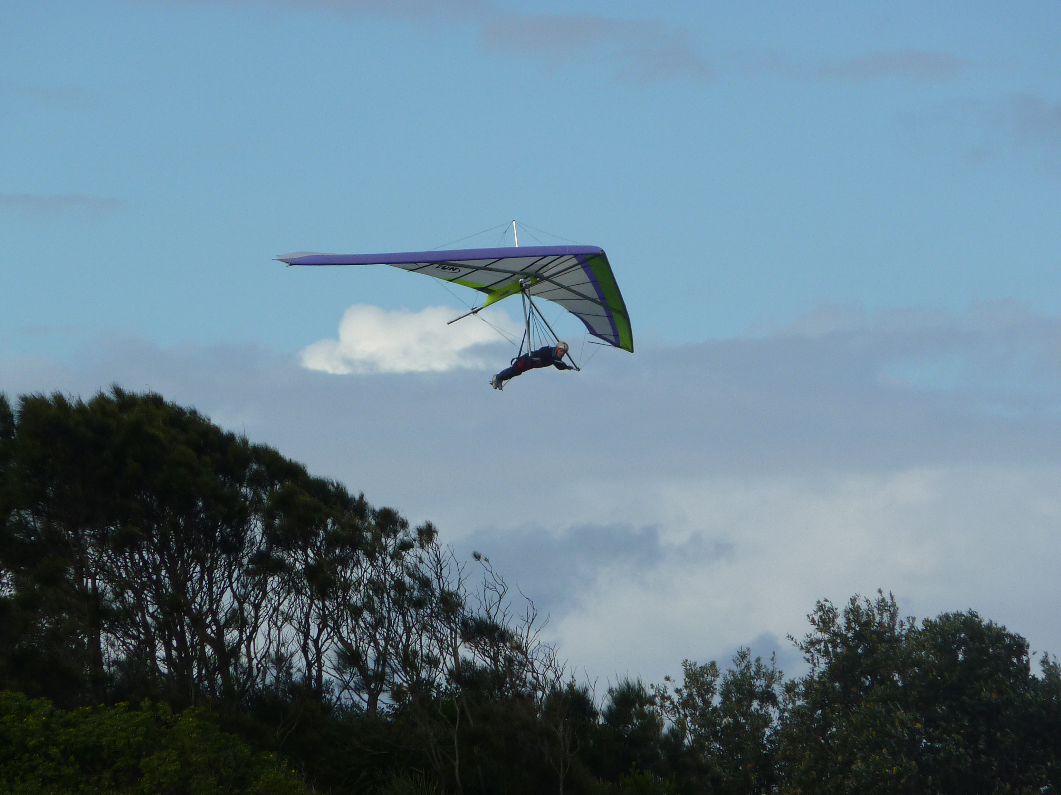
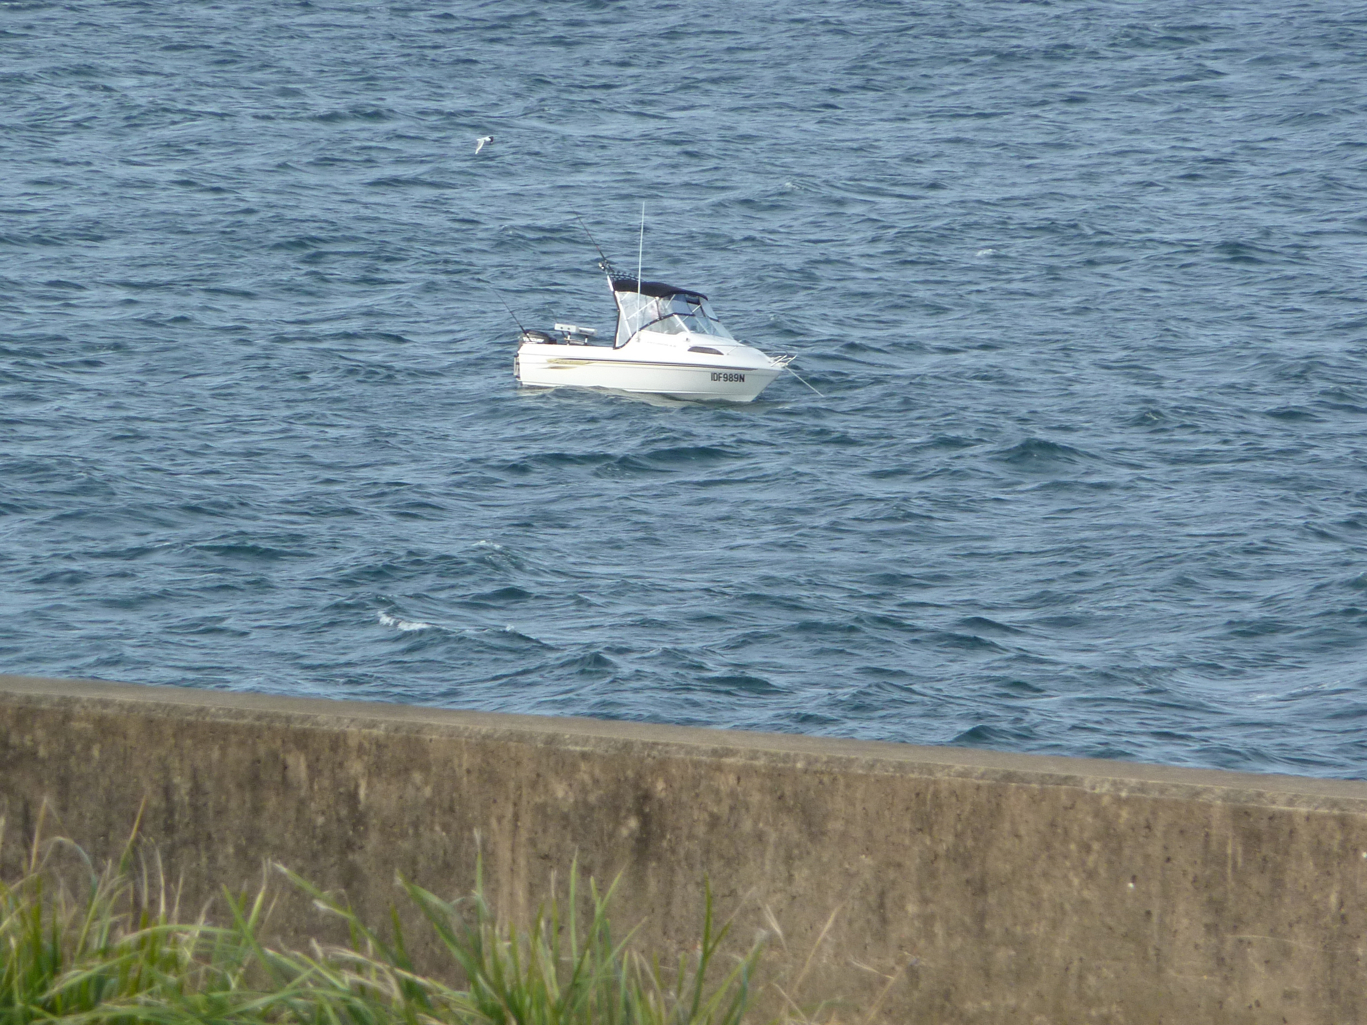
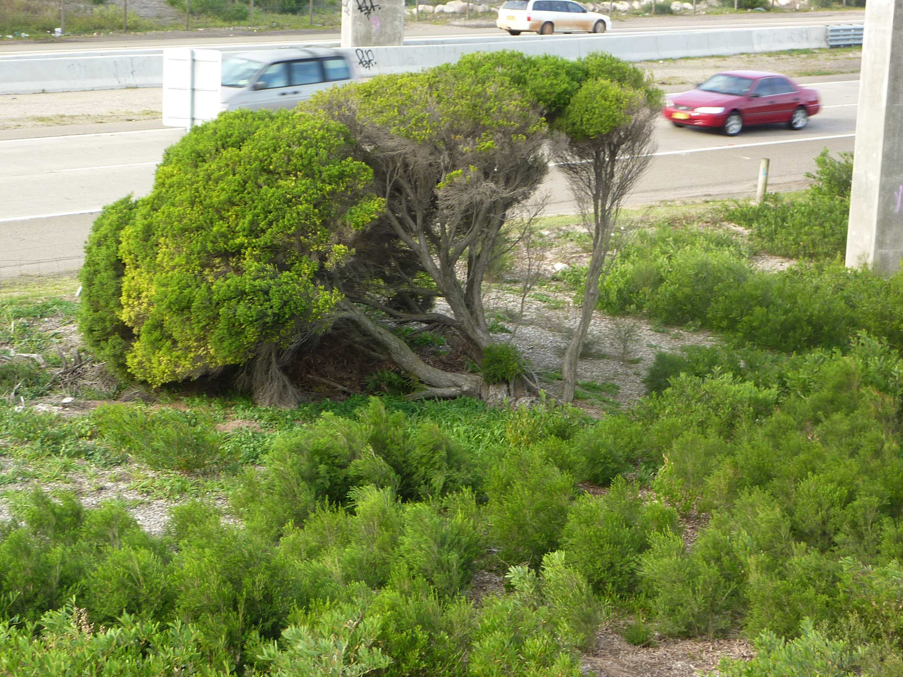
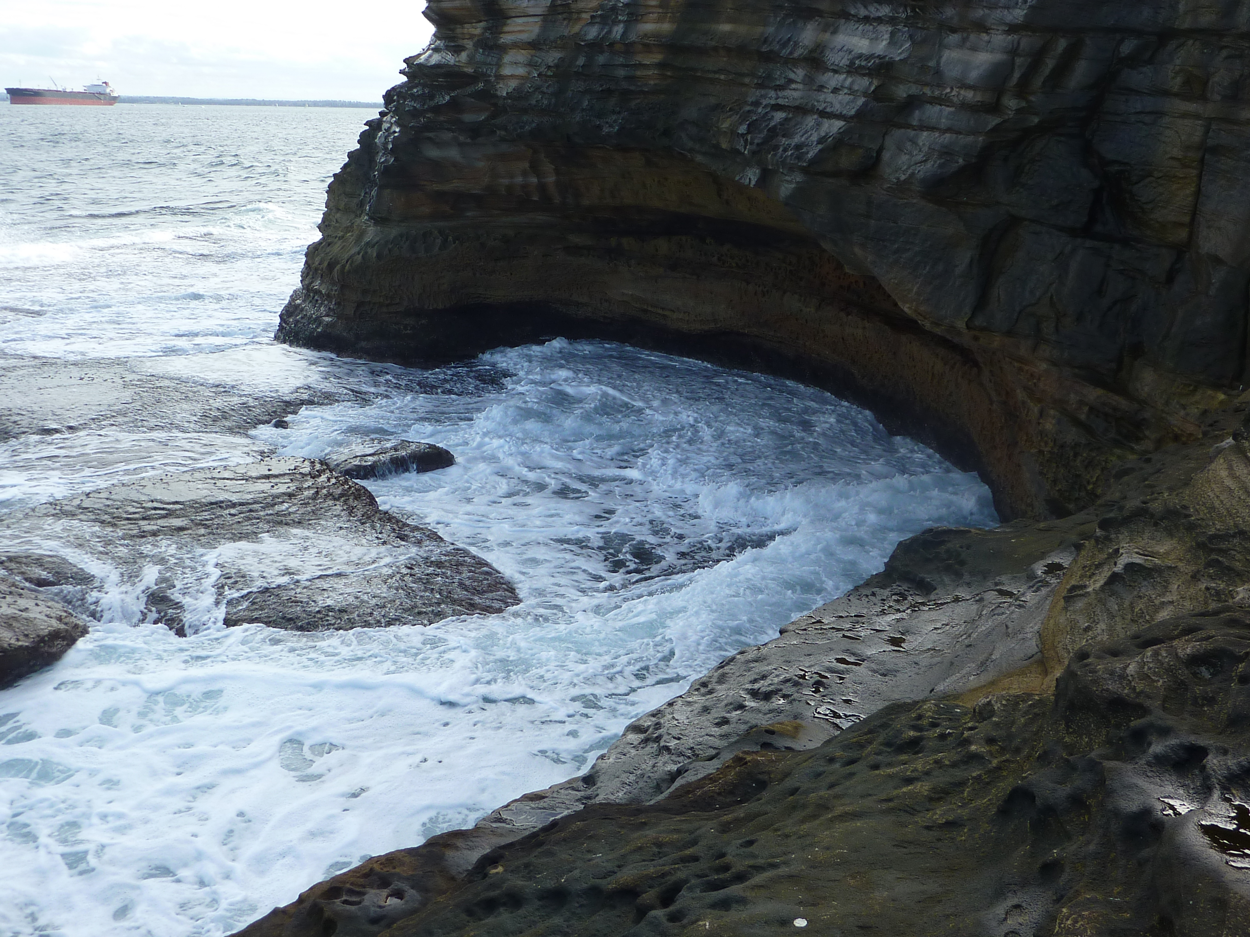
Atmosphere
Hydrosphere
Why is it there?
What are the effects of it being there?
(5.1, 5.4, 5.6)
Biosphere
Lithosphere

Slide 6
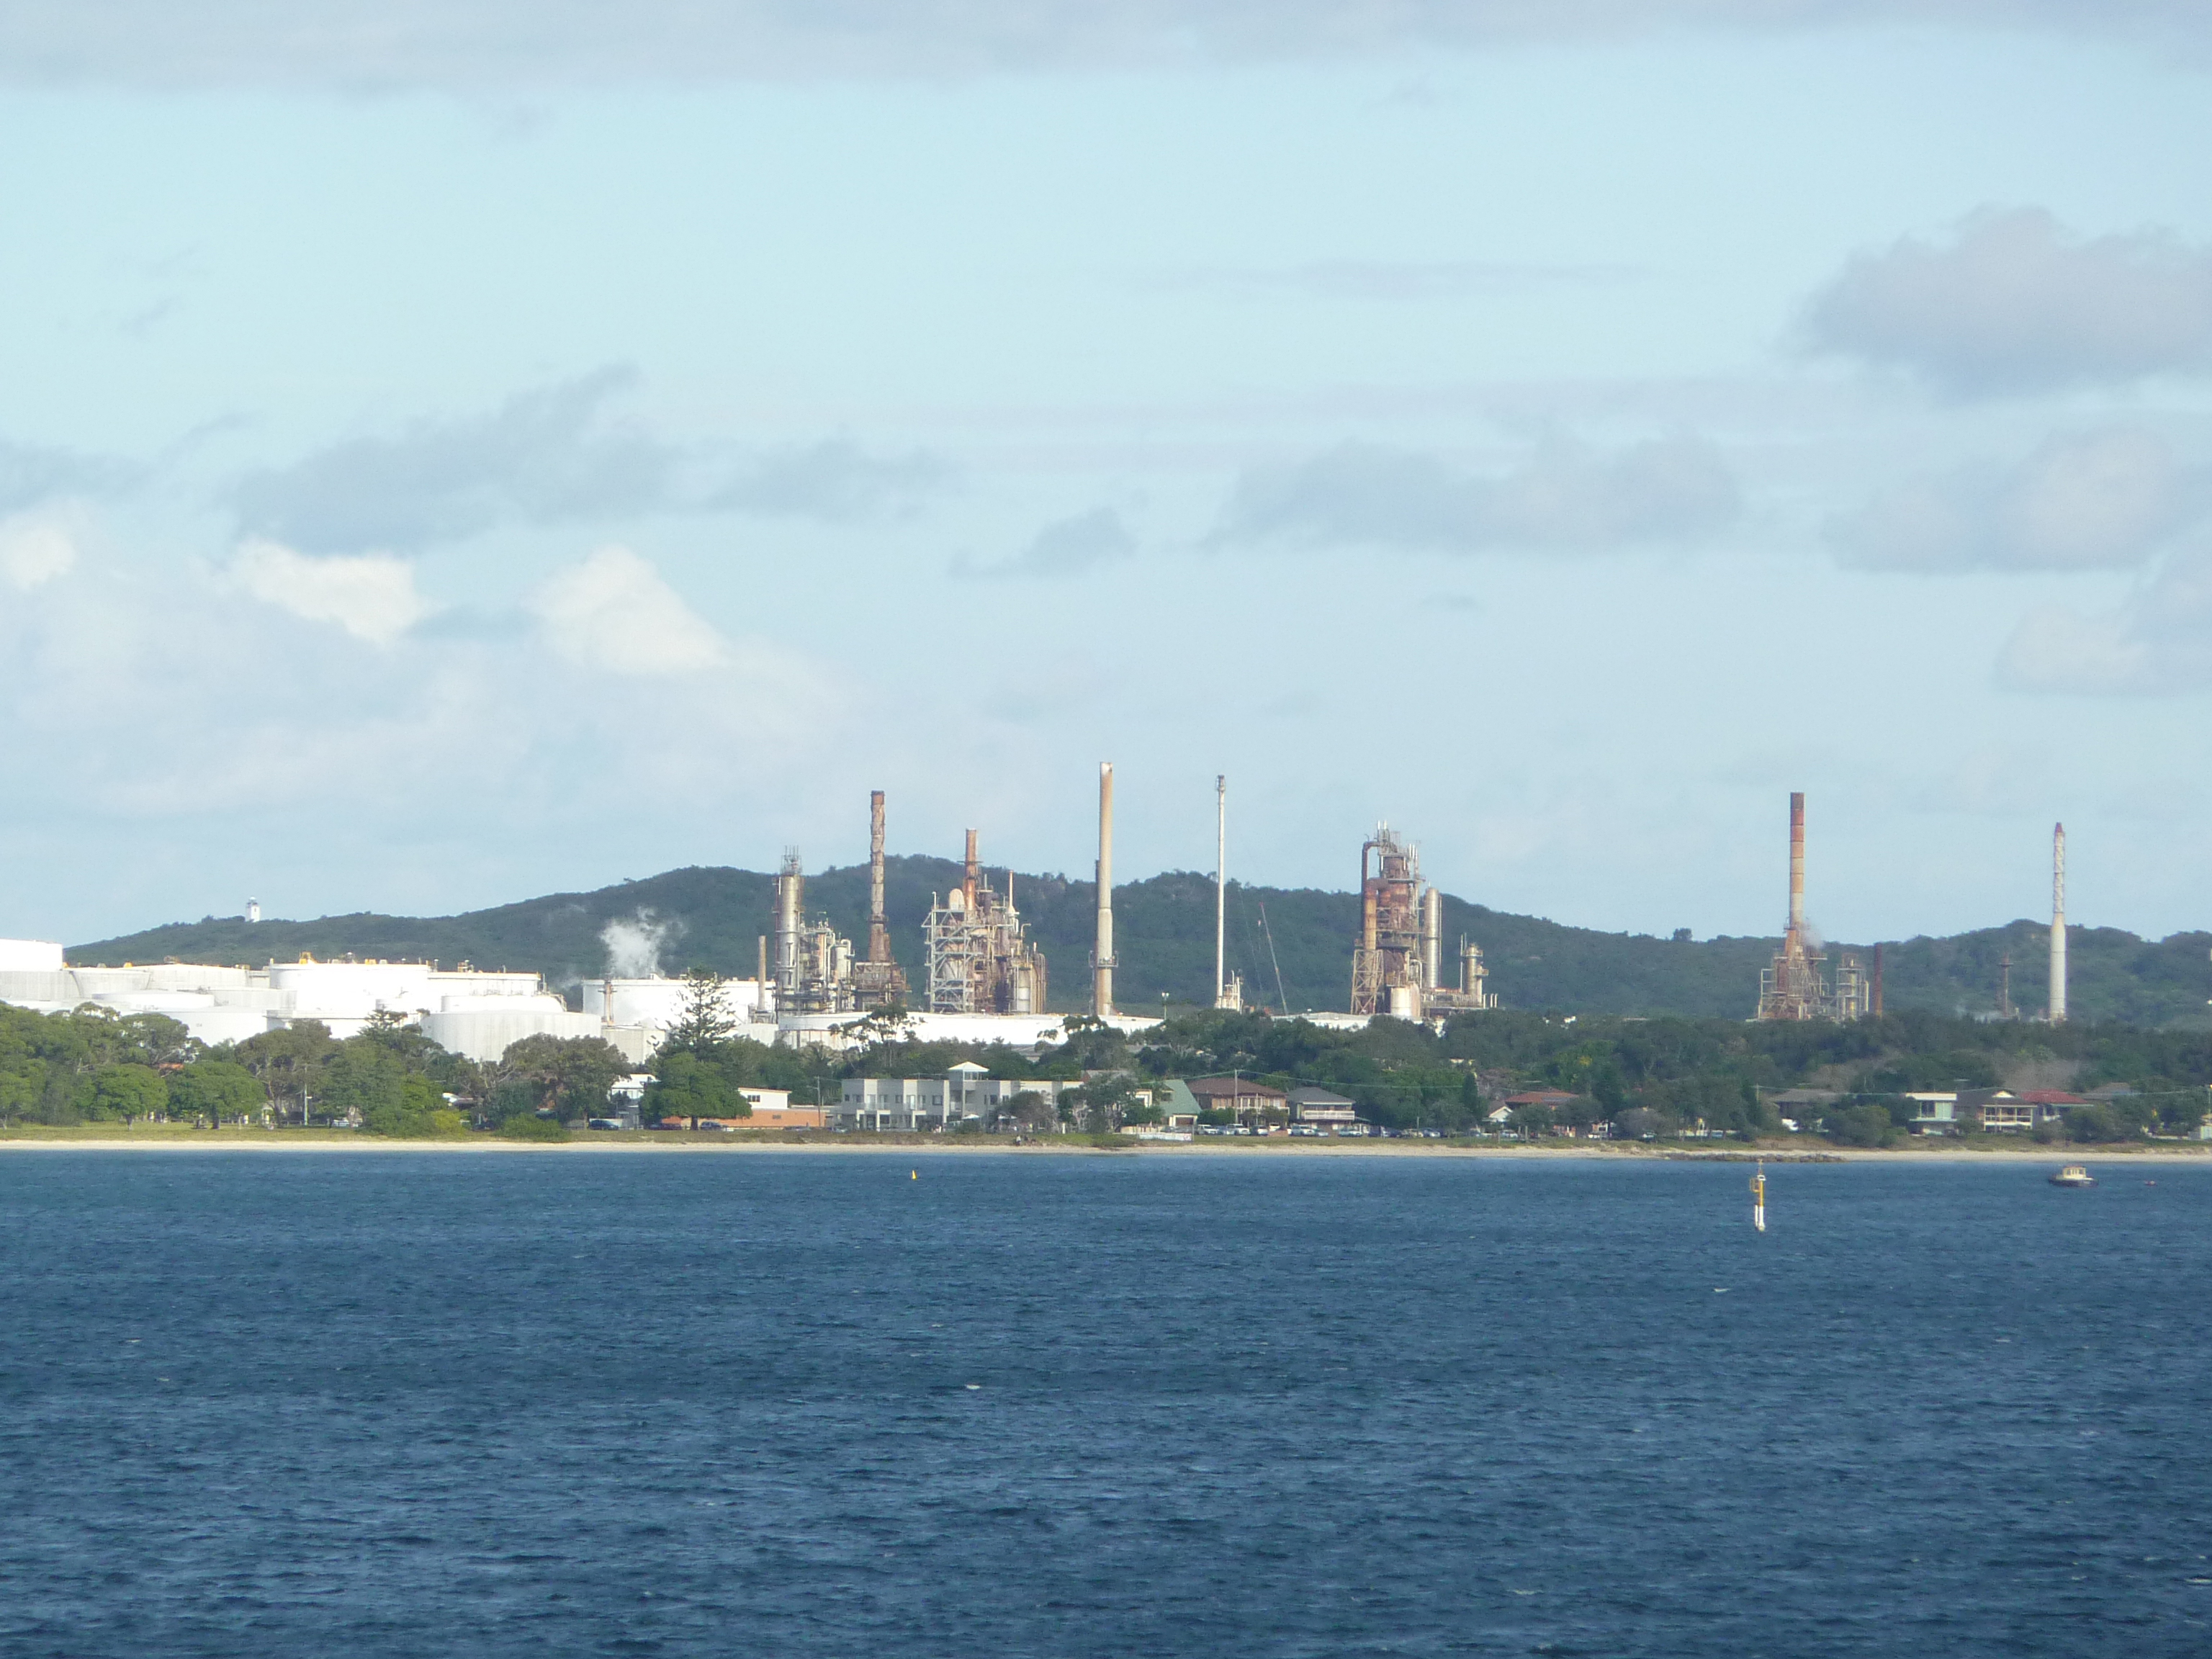
How is it changing?
Should it be like this? (5.2, 5.3)
Human impacts
How are humans changing the biophysical and built environments?

Slide 7
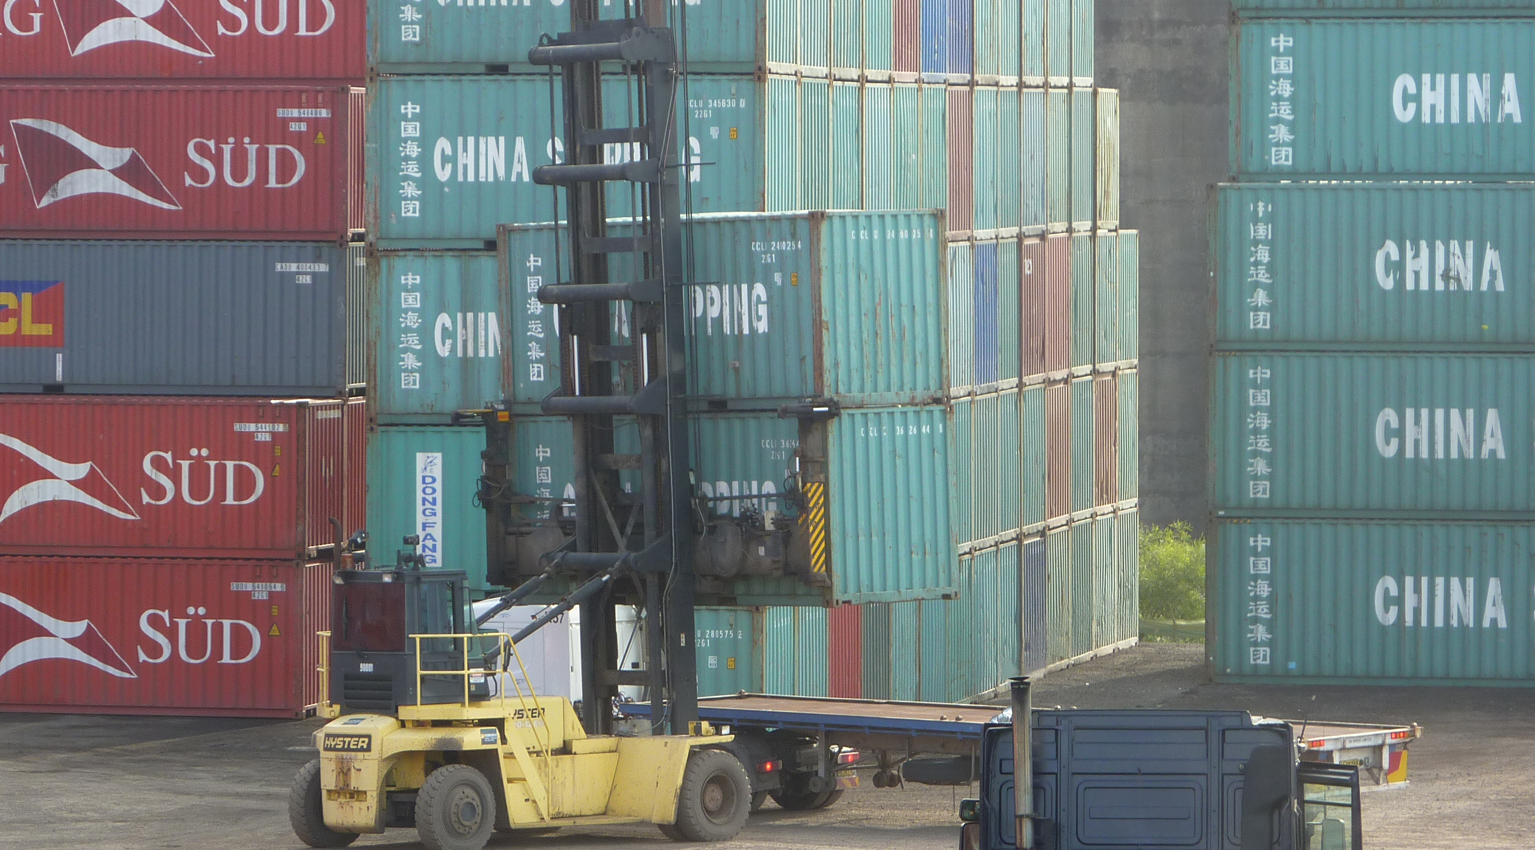
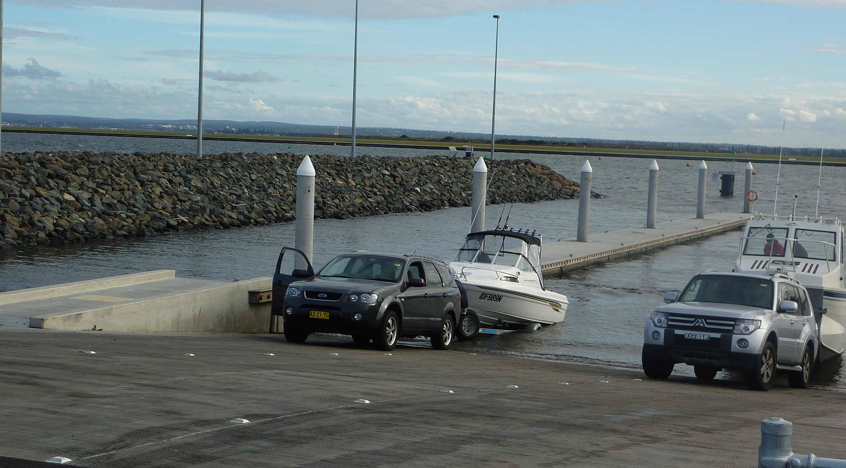
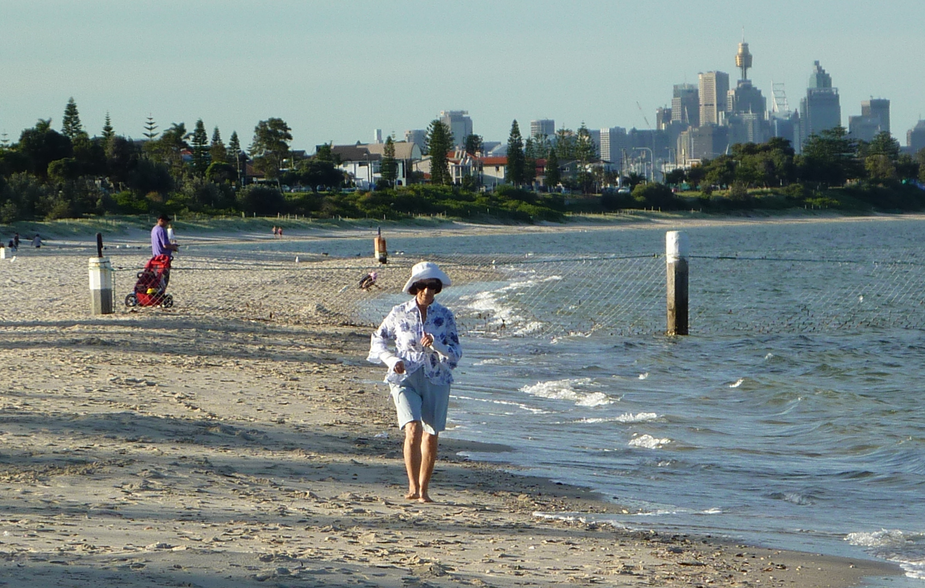
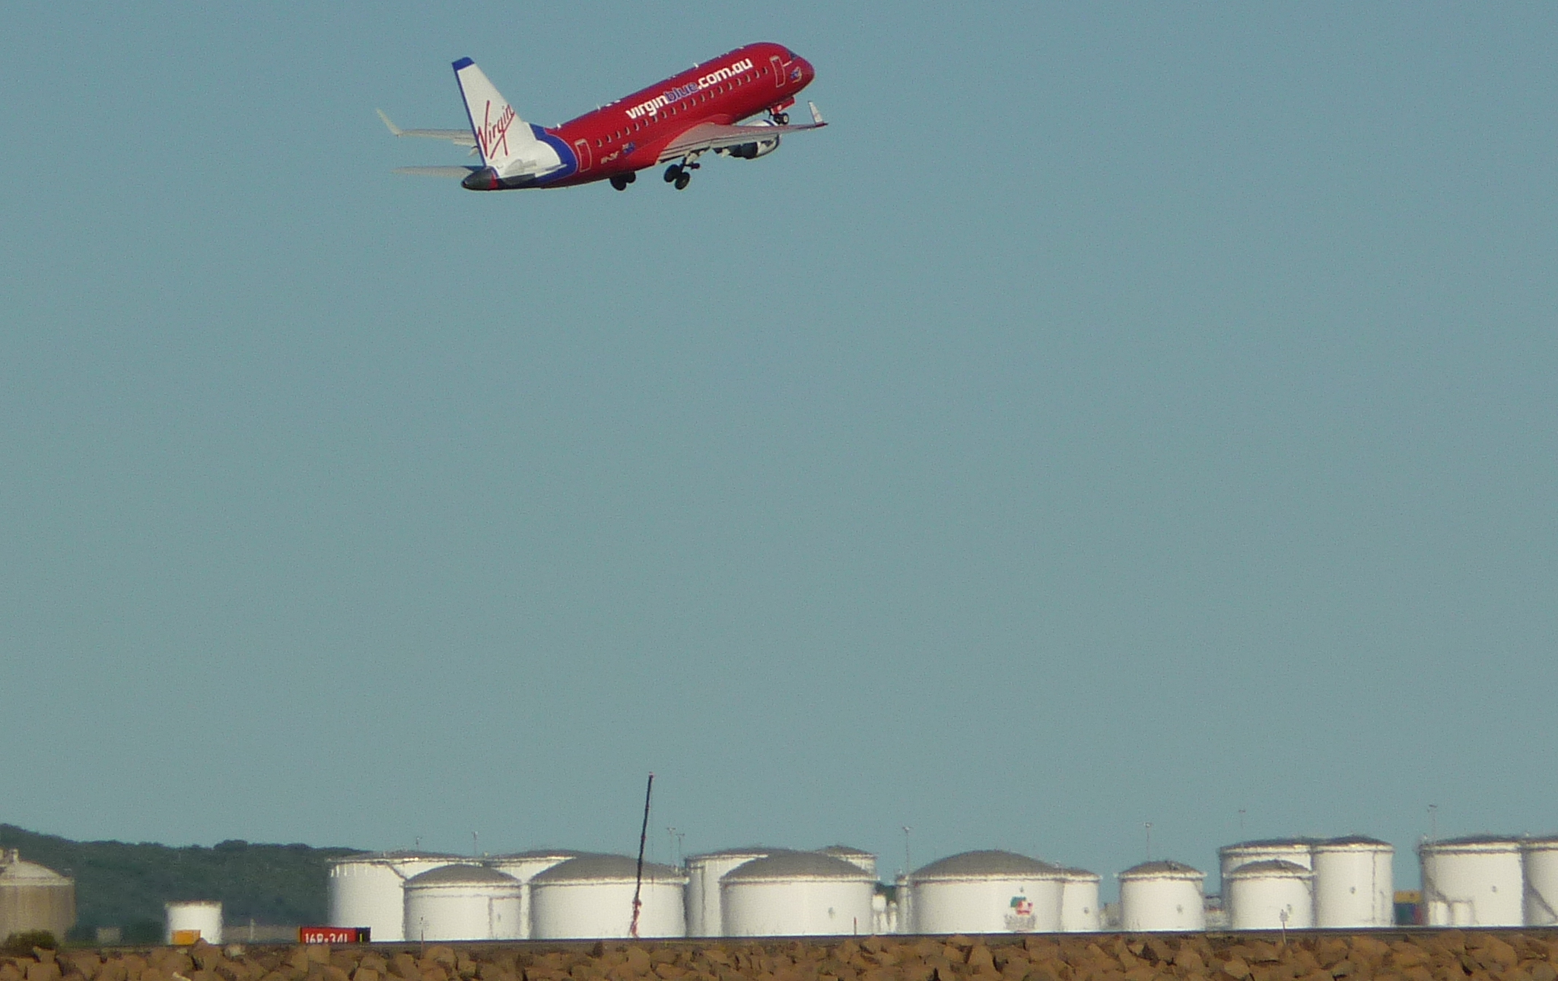
Port Botany
Fishers
Who’s involved? What do they think?
(5.3, 5.7)
Recreational visitors
Airport
Bulk fuels handlers

Slide 8
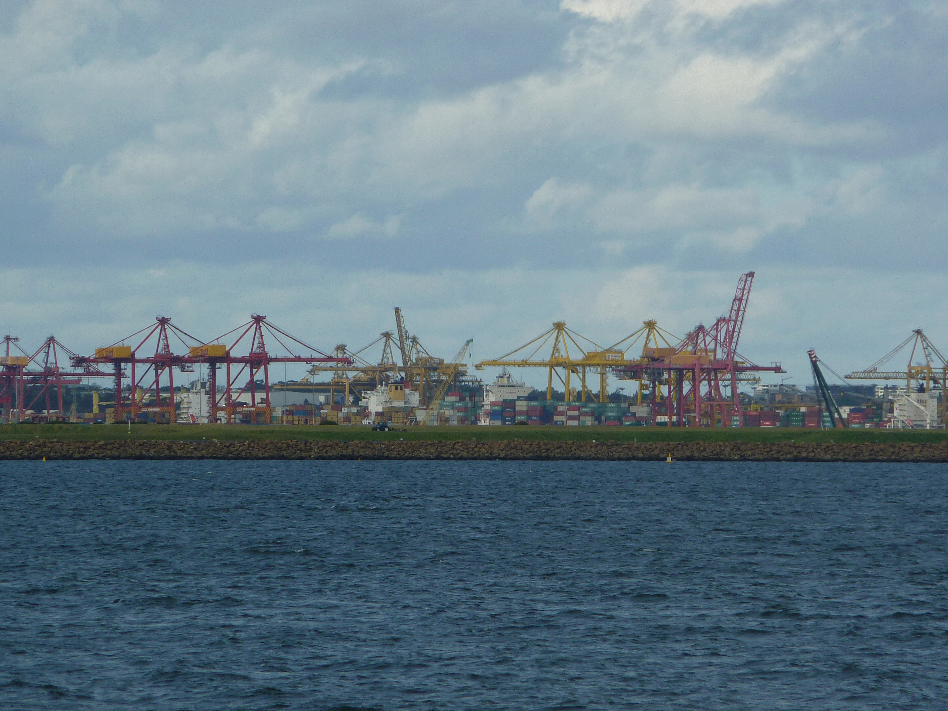
What action is appropriate? (5.3, 5.7)
Management
What’s being done about the human impacts?

Slide 9
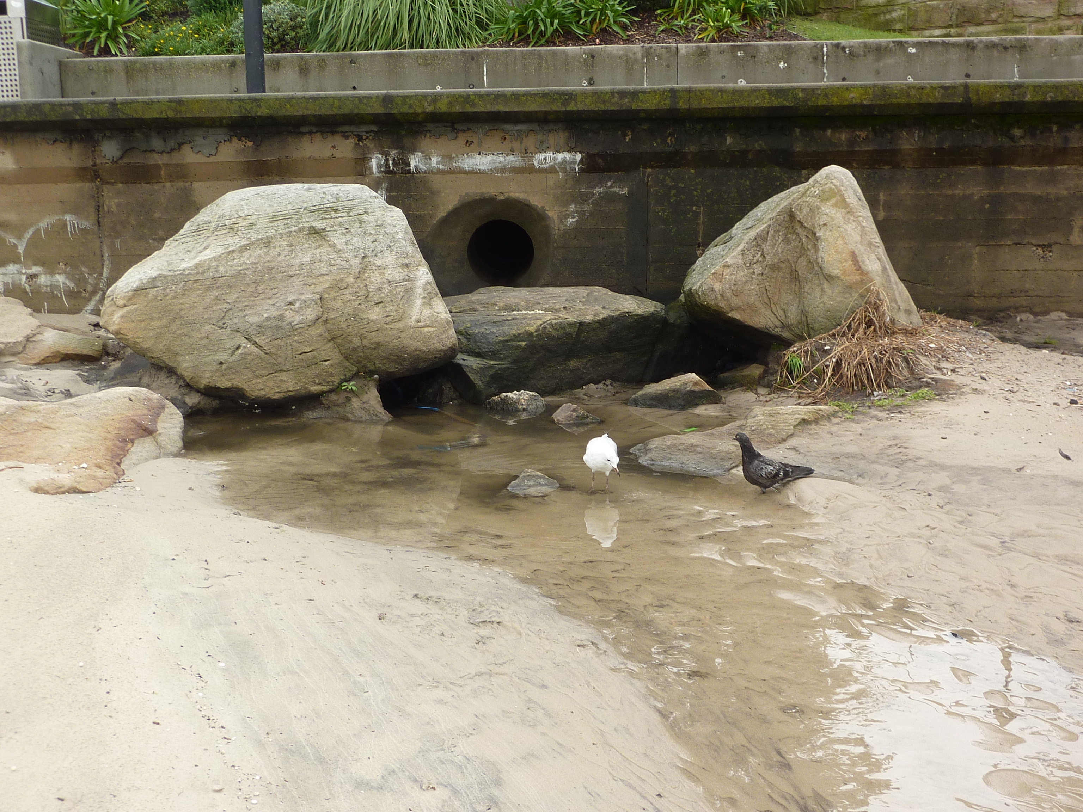
What action is appropriate? (5.10)
Stakeholders taking action
Is it ensuring sustainability, social justice and equity

Slide 10
The research questions
How have humans had an impact on the biophysical and built environment?
What issues have arisen from these impacts?
What measures are used to managed the impacts in ways that ensure sustainability, social justice and equity

Slide 11
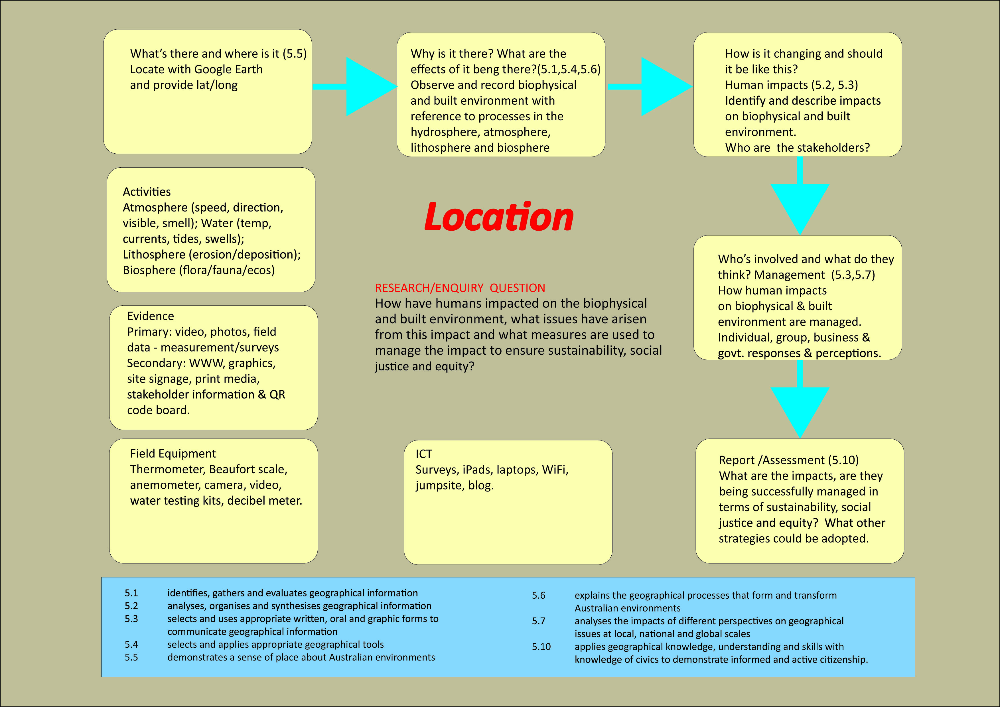
Mapping the field study from the syllabus

Slide 12

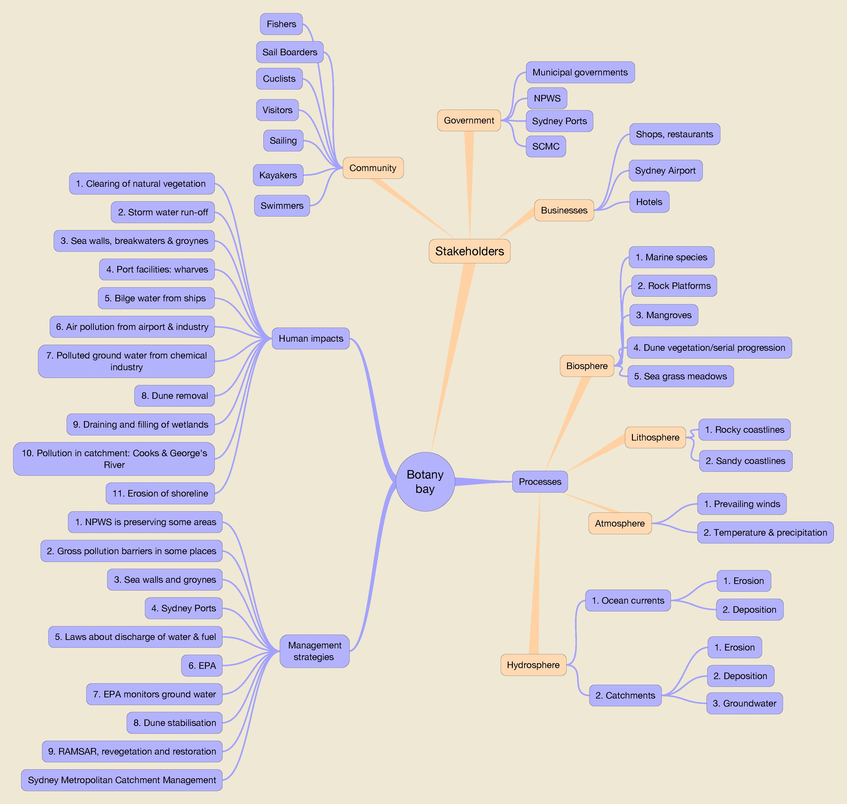
Planning the field study with iThoughtsHD

Slide 13
Building the Virtual Field Study
Primary sources
Secondary sources
photographs
videos
online survey
weblinks
QR code gallery
school’s geography blog
PowerPoint presentation

Slide 14






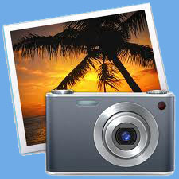


Applications used to build the Virtual Field Study
Photoshop
PowerPoint
iThoughtsHD
Illustrator
Suyrvey Monkey
Premier
iMovie
iPhoto
Dreamweaver

Slide 15

Delivering the virtual excursion
Practical considerations:
  Staff development
  Students without laptops
  Background information on content prior to excursion
  Digital equipment: laptops, data projectors, speakers & USB’s for each teacher (5-6)

Slide 16
Up skill for staff and student
Staff
Student
Exploring excursion with teachers and providing them with the template to follow to ensure students are working to meet the timeline for the assessment. (see teacher instructions)
Reviewing OneNote, Edmodo group – turning in assessment , the virtual website, PowerPoint, FreeMind, Survey monkey, QR code virtual museum – how to read them, data projector and speaker set up in the class
Exploring excursion with students and providing them with the template to follow to ensure they are working to meet the timeline for the assessment.
Reviewing OneNote, Edmodo group – turning in assessment , the virtual website, PowerPoint, FreeMind, Survey monkey, QR code virtual museum – how to read them

Slide 17

In the classroom
Explain the concept of a virtual field study
Students copy data from USB to their laptops
Viewing the introductory video
Exploring and navigating site with teacher instruction

Slide 18
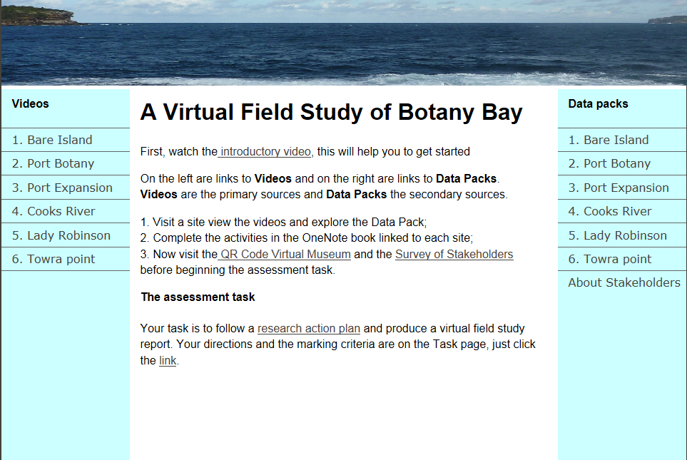
Primary
Data
Video introduction
Secondary
Data
QR codes
explained
Link to results
Link to assessment
Explanation & diagram
Explanation
Notes:
Explain the virtual field study and what is expected
Field study is copied on to each students laptop from a teacher USB
Use a data projector and speakers to view introductory video
Navigate field study website with the students
View introduction video
View Video of Site 1 (Bare Island) Primary sources
Open Data pack for site 1 (Bare Island) Secondary sources (weblinks)
Then open OneNote book for Bare Island

Slide 19
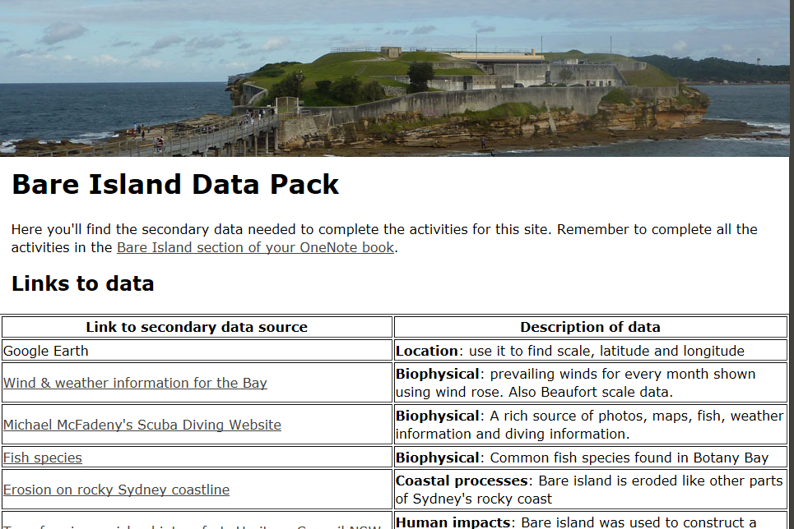
Inside the Data pack
Link to a OneNote book
Link to secondary data
Headings match OneNote
Notes:
Complete each page of the OneNote book for each of the 5 sites
Project based learning, teacher acts as a facilitator of learning
Which will free up the teacher to help students who are having difficulties
Explain the link of the virtual excursion to help complete the assessment task

Slide 20
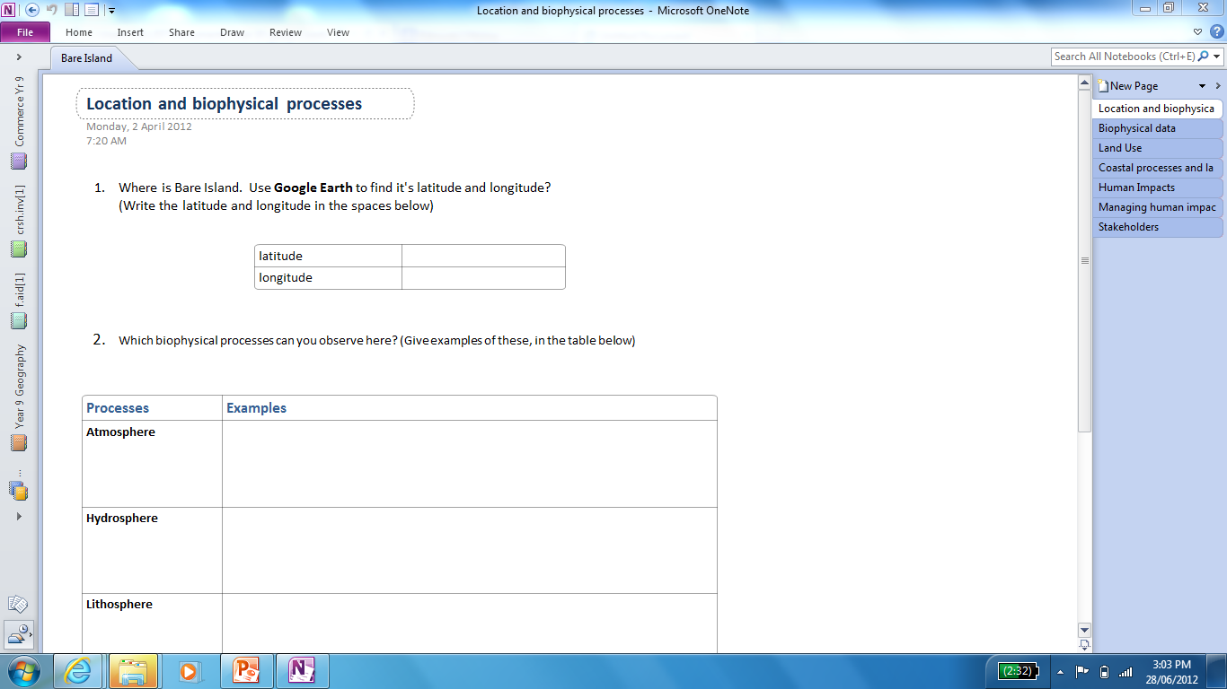
One location to a section
Pages match Data Pack
Students record fieldwork findings

Slide 21
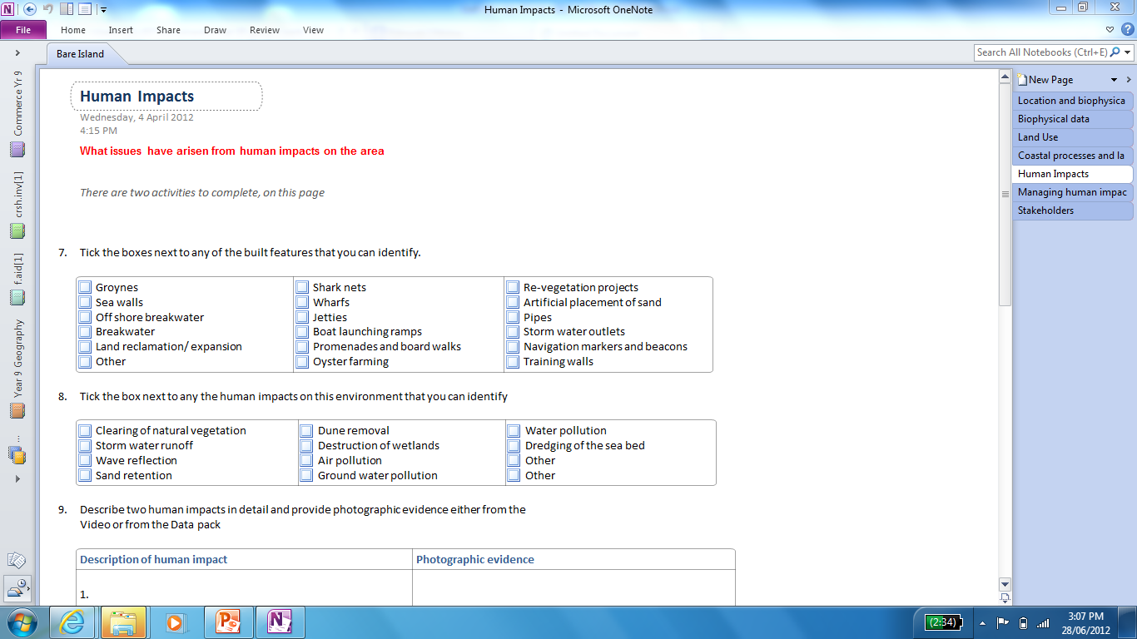
1 of 6 sites
By viewing the video, tick each box appropriate to this site (template page for each site)

Slide 22









The assessment task
Give students a variety of ideas on how to present their digital assessment in a creative way
PowerPoint
Video
Website
Blog
Word document
edublog
Podcast
Mind map
Prezi
Animation

Slide 23

The final product
Join the Edmodo group code: unqxff named C4E SSCL – virtual excursion
To view a selection of students digital assessment tasks that were submitted

Slide 24
Evaluation
Selective classes :
  enjoyed the challenge and were highly engaged, enjoyed student centred learning with teacher facilitation
  Some laptops were not functioning which caused some delays, TSO issuing loan laptops when required
Comprehensive classes:
  had more difficulty completing the OneNote pages, needed more guidance and preparation
  most did PowerPoint presentations

Slide 25
How could we improve?
differentiation between the selective and comprehensive classes.
Ensure a more obvious connection between the OneNote research and the assessment
Ensure all websites are live and operating
Ensure previous knowledge of digital software ie. OneNote and other digital tools
Have a pool of laptops available as back up

Slide 26
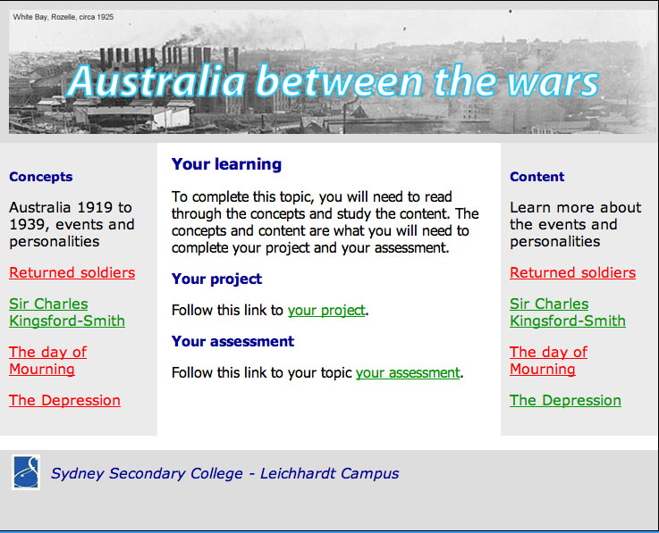
Other possibilities……History…
Notes:
Using this template of the Virtual excursion, you could transfer it to any subject and topic. As seem by this history example.

Slide 27
We hope you’ve enjoyed our presentation ☺
Your feedback is valuable
Please complete Edmodo Poll
Group Code - unqxff
C4E SSCL – virtual excursion

